Slide 1
BTC to INR Price Prediction
A Python Project
- Tharun

Slide 2
Price prediction for a whole month
Predicted the price variations for the whole month
The predicted result was accurate enough without overfitting.

Slide 3
Technology used
Python
Deep Neural Networks with a single layer
RNN
LSTM

Slide 4
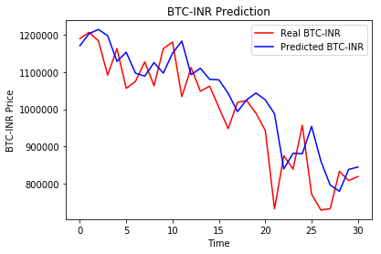
Result Obtained

Slide 5
Thank You

